Slide 1
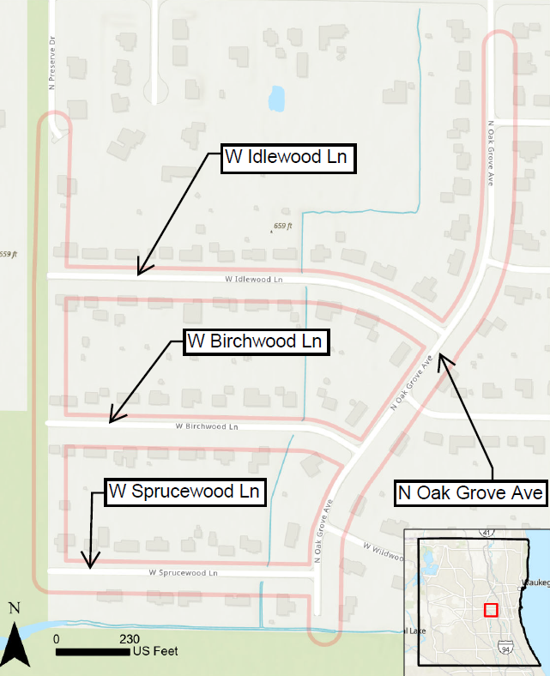
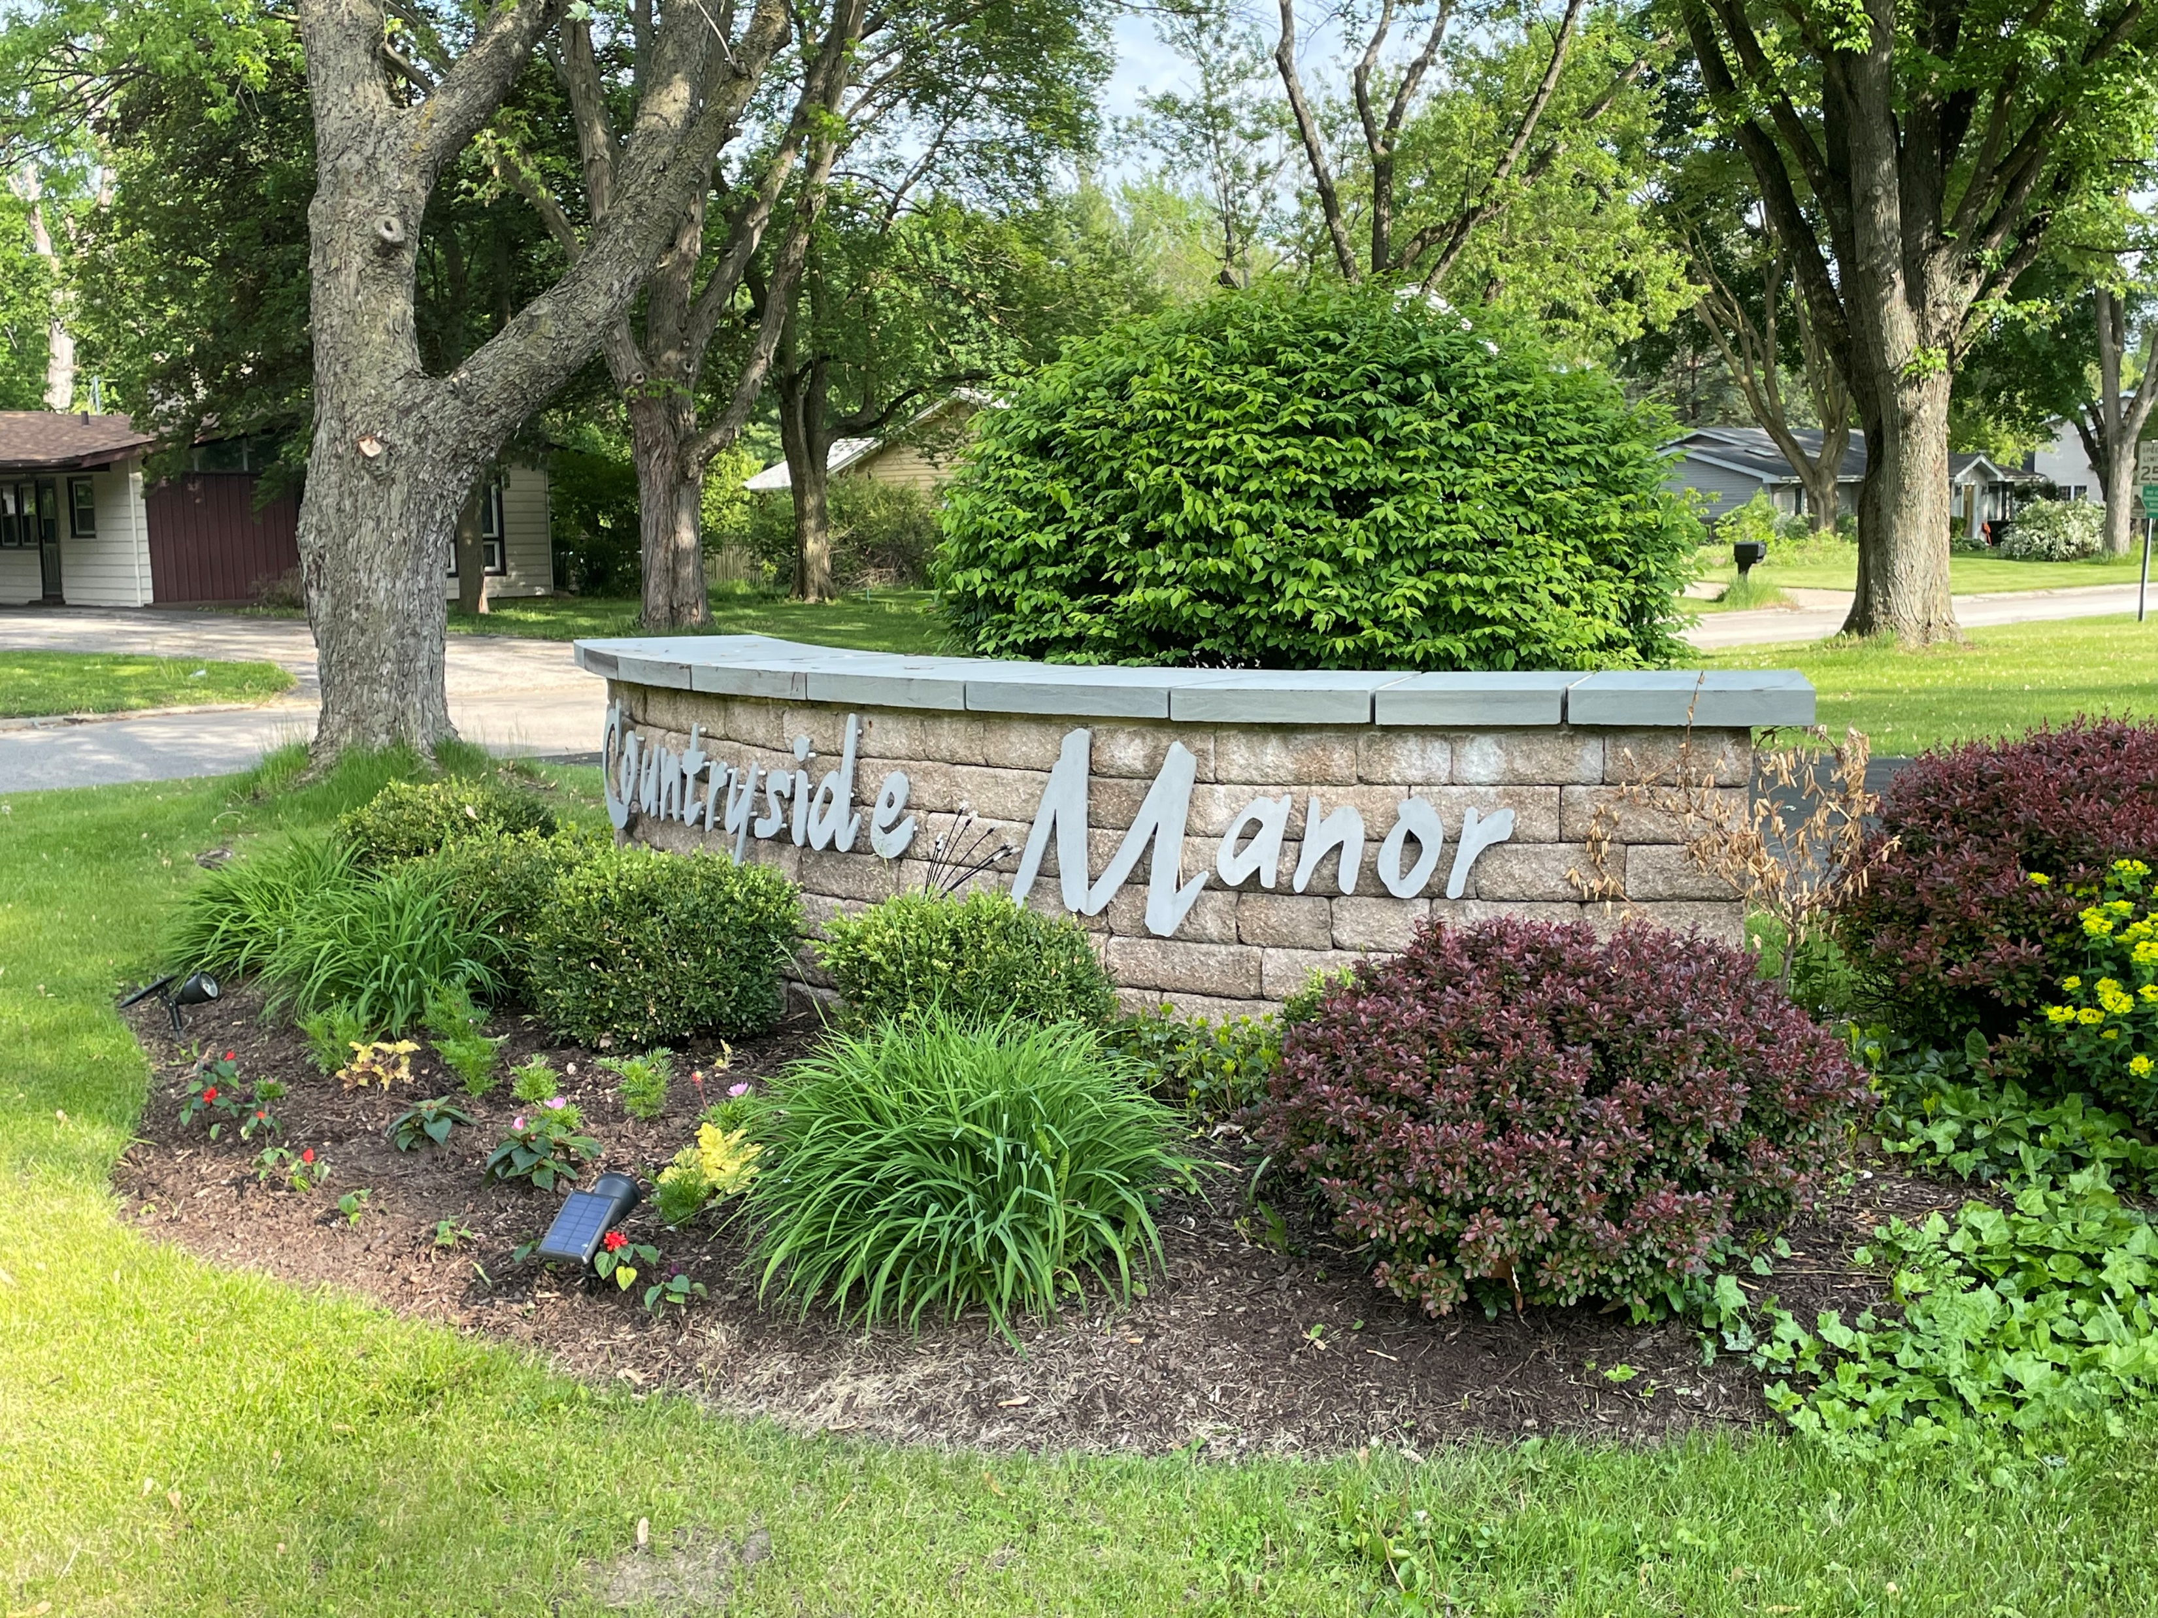
Countryside Manor Water Main Replacement Phase 2 Project

